Slide 1
Chapter 4 Human Geography: People and Places
Geography and the environment help shape human cultures, but humans also
use and alter the environment to fulfill their needs.

Slide 2
Section 1: The Elements of Culture
Section 2: Population Geography
Section 3: Political Geography
Section 4: Urban Geography
Section 5: Economic Geography

Slide 3
Section 1: The Elements of Culture
Human beings are members of social groups with shared and unique sets of behaviors and attitudes.
Language and religion are two very important aspects of culture.

Slide 4
Defining Culture
Culture
• Knowledge, attitudes, behaviors shared over generations is culture
Culture involves: food, religion, shelter, language, education, political and social organization.
• Society is a group that shares geographic region, identity, culture
• An ethnic group shares language, customs, common heritage

Slide 5
Culture Change and Exchange
Culture and societies are always in the process of changing. The following are all ways that cultures and societies can change.
Innovation
• Innovation is creating something new with existing resources, may happen on purpose or by accident.
• Example: weaving baskets from reeds to solve storage problem
Diffusion
• Spread of ideas, inventions, patterns of behavior called diffusion
• Cultural hearth—site of innovation; origin of cultural diffusion
• Example: Nile River civilizations in Africa

Slide 6
Continued Culture Change and Exchange
Acculturation
• Acculturation—society changes because it accepts innovation.
Example of this might be a group wearing jeans instead of wearing traditional garments.

Slide 7
Language
Importance of Language
One of the most important aspects of culture:
• Enables people within a culture to communicate
• Reflects all aspects of culture
Language and Identity
• Language helps establish cultural identity, unity if it is only language spoken in
• Language can also divide people and cause conflict if there are multiple languages spoken and one is favored.

Slide 8
Continued Language
Language Families
• Between 3,000 and 6,500 languages spoken worldwide
• Similar languages belong to same language family and stem from one original language, like the Indo-European language is the basis for many others.
• Dialect—a version of a language, like Southern drawl
Language Diffusion
• Language can spread via trade routes, may have created a language to aid in trading.
May also spread through migration, people carry language with them as they settle.

Slide 9
Religion
Religion is another aspect that has a great deal of influence of people’s lives.
Belief Systems
• Religion—belief in supernatural power that made, maintains universe
• Monotheistic faiths believe in one god
• Belief in many gods called polytheistic
• Animistic, or traditional, faiths believe in divine forces of nature
Spread of Religion
• Religion spreads through diffusion and conversion
• Conversion—some religions try to recruit others to their faith

Slide 10
Major Religions
Judaism
• Monotheistic; evolved 3,200 years ago; holy book called the Torah.
Followers called Jews. Main city is Jerusalem.
Christianity
• Evolved from Judaism; based on teachings of Jesus Christ
• Largest religion—2 billion followers worldwide
Islam
• Monotheistic; based on teachings of Prophet Muhammad
• Followers, called Muslims, worship God, called Allah
• Holy book called the Qur’an

Slide 11
Continued Major Religions
Hinduism
• Polytheistic; evolved in India around 5,000 years ago
• Hindu caste system has fixed social classes, specific rites/duties
Buddhism
• Offshoot of Hinduism; evolved around 563 B.C. in India
• Founder Siddhartha Gautama, called the Buddha, or Enlightened One
• Rejects Hindu castes; seeks enlightened spiritual state, or nirvana
Other Asian Practices
• Include Confucianism, Taoism, Shinto

Slide 12
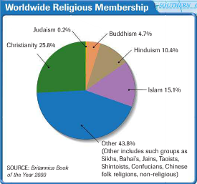
Major Religions

Slide 13
Creative Cultural Expressions
Creative Cultural Expressions
• All cultures express themselves creatively
• Cultures produce performing arts, these include music, dance, theater, film
Visual arts include architecture, painting, sculpture, textiles are forms of visual arts.
Oral and written literature include poems, folk tales, stories

Slide 14
Section 2: Population Geography
• People are not distributed equally on the earth’s surface.
• The world’s population continues to grow, but at different rates in different regions.

Slide 15
Worldwide Population Growth
Birth and Death Rates
• Number of live births per thousand population is the birthrate
• Fertility rate—average, lifetime number of children born to a woman
• Number of deaths per thousand people is the mortality rate
• Infant mortality rate—deaths under age 1 per 1,000 live births
• Population growth rate, or rate of natural increase, figured by:
- subtracting the mortality rate from the birthrate

Slide 16
Continued Worldwide Population Growth
Population Pyramid
• A population pyramid shows a population’s sex, age distribution
• Enables the study of how events (wars, famines) affect population

Slide 17
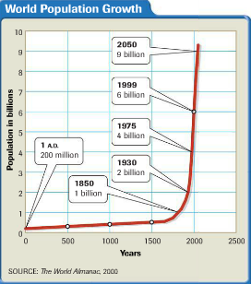
Continued Worldwide Population Growth

Slide 18
Population Distribution
Billions of people on the Earth are not distributed equally. Several factors influence where people live.
Habitable Lands
• 2/3 of world’s population lives between 20˚N and 60˚N latitude
• Human habitation in this zone:
- dense where temperature and precipitation allow agriculture
- also dense along coastal areas and in river valleys
- more sparse in polar, mountain, desert regions
Urban–Rural Mix
• More than half of world’s population rural; rapidly becoming urban

Slide 19
Continued Population Distribution
Migration
Large scale migration from one location to another alters the distribution of population.
• Reasons for migrating sometimes called push-pull factors
• Push factors (drought, war) cause migration from an area
• Pull factors (favorable economy, climate) spur migration to an area

Slide 20
Population Density
Population density helps geographers understand how heavily populated an area is.
Estimating Population
• Population density is the average number of people living in an area.
Because population is not distributed evenly, the number may be misleading. (Alaska has one per square mile, while New Jersey has 1,098).

Slide 21
Population Density
Carrying Capacity
• Carrying capacity is the number of organisms an area can support
affected by fertile land, level of technology, economic prosperity.
Singapore is able to support millions of people, even though it has small amounts of farming ground. But it is a great trading center and this allows for the mass import of food.

Slide 22
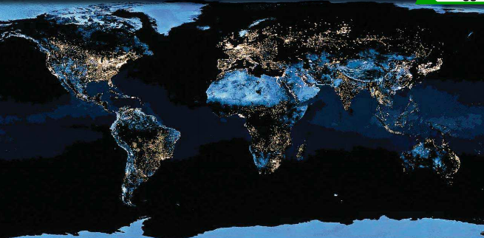
Population Density

Slide 23
Section 3: Political Geography
• The world is divided into many political regions.
• Local, national, and regional governments control aspects of life within the boundaries of the unit.

Slide 24
Nations of the World
Governmental units of the world can be described in either political or geographic terms.
.• An independent political unit, a state, or country:
- occupies specific territory
- controls its internal, external affairs
• Nation—unified group with common culture living in a territory
• A nation and state occupying same territory is a nation-state

Slide 25
Continued Nations of the World
Types of Government
• In a democracy, citizens hold political power
• Political power held by a king or queen is a monarchy
• In a dictatorship, a group or individual holds all political power
• Communism is a governmental and economic system
- political, economic power held by government in people’s name

Slide 26
Geographic Characteristics of Nations
Size
• Physical size does not accurately reflect political, economic power
Shape
• Shape affects governance, transportation, relations with neighbors
Location
• A landlocked country has no direct outlet to the sea
- may limit prosperity, as shipping and trade bring wealth
• Hostile neighbors necessitate increased security

Slide 27
National Boundaries
Boundaries or borders set the limits of a territory controlled by a state.
Natural Boundaries
• Formed by rivers, lakes, mountain chains
Artificial Boundaries
• Fixed line, generally following latitude, longitude:
• Example: 49 degrees N latitude separates U.S. from Canada
- often formally defined in treaties

Slide 28
Regional Political Systems
Political Subdivisions
• Countries divide into smaller political units like cities, towns
• Smaller units combine regionally into counties, states, etc.
• Countries may join together to form international units:
- examples: United Nations, European Union

Slide 29
Section 4: Urban Geography
• Nearly half the world’s population lives in urban areas.
• Cities fulfill economic, residential, and cultural functions in different ways.

Slide 30
Growth of Urban Areas
Today, much of the population of the world lives in cities.
• Urban geography is the study of how people use space in cities
• Cities are populous centers of business, culture, innovation, change.
Urban lifestyles are different than those of towns or rural areas.
Urban Areas
• Urban area develops around a central city; may be surrounded by:
- suburbs—border central city, other suburbs
- exurbs—have open land between them and central city
• Central city plus its suburbs and exurbs called a metropolitan area

Slide 31
Continued Growth of Urban Areas
Urbanization
• Urbanization—rise in number of cities, resulting lifestyle changes.
The trend to live in cities increased rapidly over the last two centuries.

Slide 32
City Locations
Around the world, cities have certain geographic characteristics in common.
• Cities are often located near:
- good transportation—lakes, rivers, coastline
- plentiful natural resources
• As a result, cities tend to:
- become transportation hubs
- specialize in certain economic activities

Slide 33
Land Use Patterns
Urban Geographers also study land use, the activities that take place in cities
• Basic land use patterns found in all cities:
- residential (housing)
- industrial (manufacturing)
- commercial (retail)
• Central business district (CBD)—core area of commercial activity. Business offices and stores are found here.

Slide 34
The Functions of Cities
The city is the center of a variety of functions
• Shopping, entertainment, government services
• Educational, recreational, and cultural activities
• Transportation is essential to accomplish functions, because it takes a lot of space to accomplish the functions above.

Slide 35
The Functions of Cities

Slide 36
Section 5: Economic Geography
• Economic activities depend on the resources of the land and how people use them.
• The level of economic development can be measured in different ways.

Slide 37
Economic Systems
Economic activities depend on the resources of the land and how people use them.
• Economy—the production and exchange of goods and services
• Economies are local, regional, national, international
• Geographers study economic geography by looking at:
- how people in a region support themselves
- how economic activity is linked regionally

Slide 38
Continued Economic Systems
Types of Economic Systems
• Economic system: way people produce and exchange goods, services
Four types of economic systems:
- traditional, or barter, economy, traded w/o Money
- command, or planned, economy is determined by a central government
- market economy, also called capitalism, supply and demand
- mixed economy, a combination of command and market, so that all people will benefit.

Slide 39
Economic Activities
Types of Economic Activity
People may choose from a variety of methods to meet their basic needs.
• In subsistence agriculture, food is raised for personal consumption
• Raising food to sell to others is called market-oriented agriculture
• Cottage industries involve small, home-based industrial production
• Large industrial production comes from commercial industries

Slide 40
Continued Economic Activities
All business operate at one of four economic levels.
• Four levels of economic activities:
- primary involves gathering raw materials for immediate use
- secondary adds value to material by changing its form
- tertiary involves business or professional services
- quaternary provides information, management, research services

Slide 41
The Economics of Natural Resources
An important part of economic geography is understanding which resources a nation possesses.
• Natural Resources—Earth’s materials that have economic value
• Materials become resources when they can be turned into goods

Slide 42
Continued The Economics of Natural Resources
Utilizing Nature’s Bounty
• Geographers divide natural resources into three types:
- renewable resources (trees, seafood) can be replaced naturally
- nonrenewable resources (metals, oil, coal) cannot be replaced
- inexhaustible resources (sun, wind) are unlimited resources
• Natural resources are a major part of world trade

Slide 43
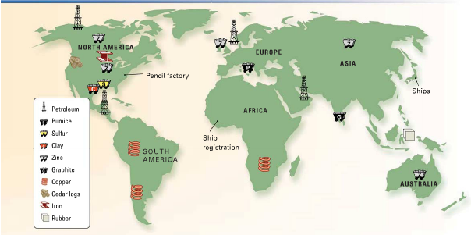
Continued The Economics of Natural Resources

Slide 44
Economic Support Systems
Producing and distributing goods and services requires a series of support systems, the most important of these is infrastructure
• Infrastructure—basic support systems to sustain economic growth
- power, communications, transportation systems
- water, sanitation, and education systems
• Communications systems and technology both critical to development

Slide 45
Measuring Economic Development
Geographers use a variety of standards to make comparisons among economies, one of this is per capita income.
• Per capita income: average earnings per person in a political unit
GNP and GDP: both measure the economy of a country.
• Gross national product (GNP)—statistic to measure:
- total value of goods, services produced by a country, globally
• Gross domestic product (GDP)—statistic to measure:
- total value of goods and services produced within a country

Slide 46
Continued Measuring Economic Development
Countries of the world have different levels of economic development.
• Developing nations have low GDP, per capita income
• Developed nations have high GDP, per capita income

