Slide 1
Chapter 3
Physical Geography
Climate and Vegetation
Climate is created by the sun’s solar energy interacting with the earth’s land, water, and air. In turn, climate and soil shape the earth’s vegetation.

Slide 2
Index
Section 1: Seasons and Weather
Section 2: Climate
Section 3: World Climate Regions
Section 4: Soils and Vegetation

Slide 3
Seasons and Weather
• Seasons and weather occur because of the changing position of the earth in
relation to the sun.
• Weather extremes are related to location on earth.

Slide 4
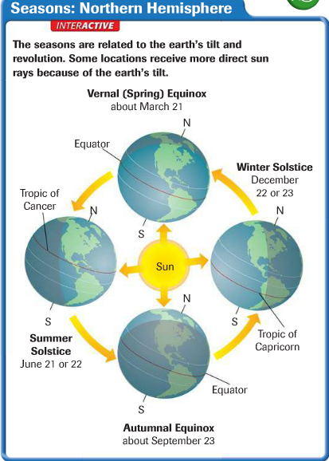
Seasons
Earth’s Tilt
• Earth is tilted at a 23.5˚ angle relative to the sun
• Areas of Earth get more, less direct sun at different times of year
• The seasons are related to the earth’s tilt and revolution
• The solstice marks beginning of summer, winter
- sun’s rays directly overhead at noon at furthest points north and south
• The equinox marks the beginning of spring and autumn
- day and night are equal in length

Slide 5
Weather
Weather and Climate
• Weather—atmospheric conditions at a particular location and time
• Climate—weather conditions at one location over long a period
• Example: Northern Russia has a cold climate

Slide 6
What Causes the Weather
• Sun: amount of solar energy received
• Water vapor: determines whether there will be precipitation
• Precipitation—water droplets falling as rain, snow, sleet, hail
• Cloud cover: clouds may hold water vapor

Slide 7
What Causes the Weather
• Landforms and bodies of water
- water heats slowly, loses heat slowly
- land heats rapidly, loses heat rapidly
• Elevation: as elevation increases, air becomes thinner
- thin air cannot hold moisture
• Air movement: distributes moisture and solar energy

Slide 8
Precipitation
Precipitation comes about when:
- warm air rises, cools, loses ability to hold water vapor
- water vapor condenses into droplets
- water droplets form clouds
- heavy clouds release droplets as rain, snow

Slide 9
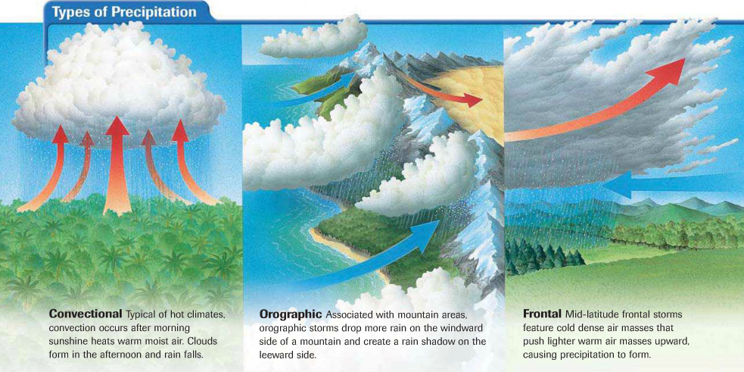
Precipitation
Three types of precipitation

Slide 10
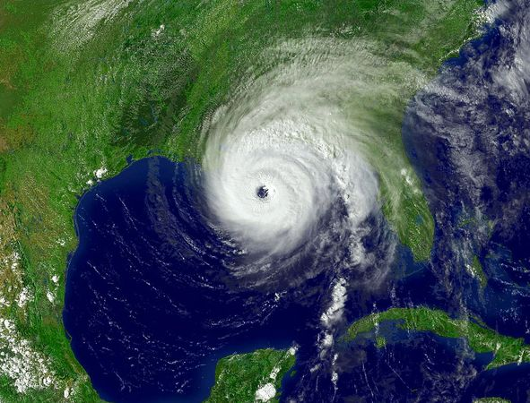
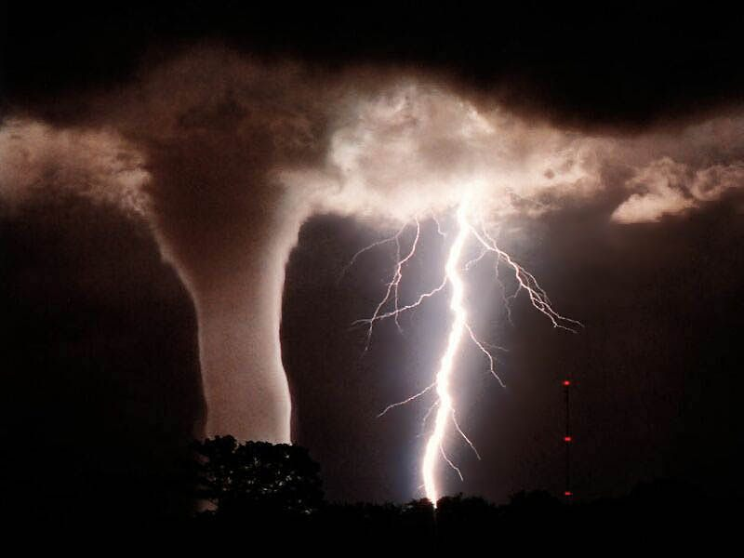
Hurricanes and Tornadoes
Hurricanes
• Huge storms called hurricanes, or typhoons in Asia:
- form over warm, tropical ocean waters
- hit land with heavy rain, high winds, storm surge
Tornadoes
• Tornado—a powerful, funnel-shaped column of spiraling air:
- born from strong thunderstorms
- capable of immense damage

Slide 11
Weather Extremes
Blizzards
• Blizzard—heavy snowstorm with strong winds, reduced visibility
Droughts
• Drought: long period of time with either no or minimal rainfall
Floods
• Water spread out over normally dry land

Slide 12
Section 2: Climate
Climate reflects the seasonal patterns of weather for a location over a long
period of time.
• Global climatic changes may be natural or human-made.

Slide 13
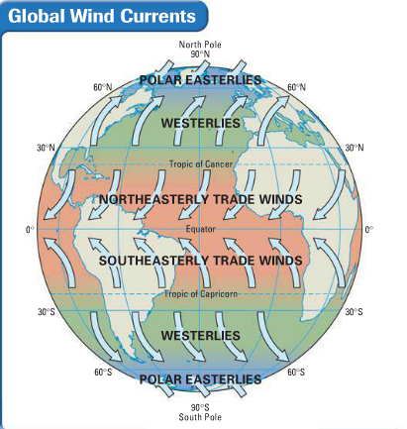
Factors Affecting Climate
Wind Currents
• Wind, ocean currents help distribute sun’s heat worldwide
• Convection—upward motion of air that transfers heat in atmosphere
• Coriolis effect is the bending of winds due to Earth’s rotation

Slide 14
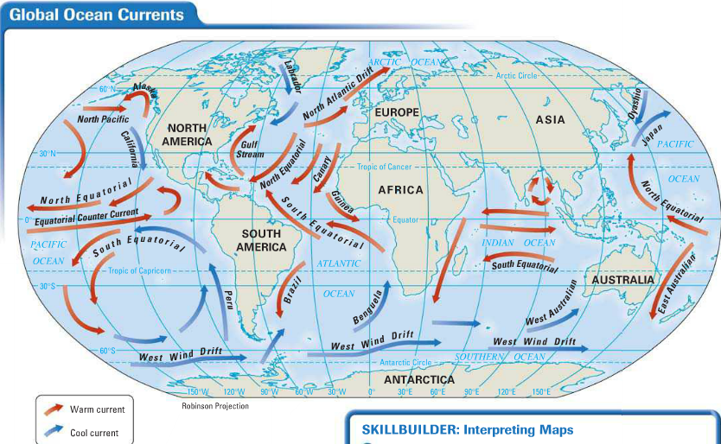
Factors Affecting Climate
Ocean Currents
• Resemble rivers flowing in the ocean
• Warm water flows away from equator toward poles
• Cold, polar water flows back toward equator

Slide 15
Factors Affecting Climate
Elevation
• Elevation is the distance above sea level
• As elevation increases, climate gets colder
Topography
• Topography: landforms and their distribution in an area
• Landforms, especially mountains, affect climate

Slide 16
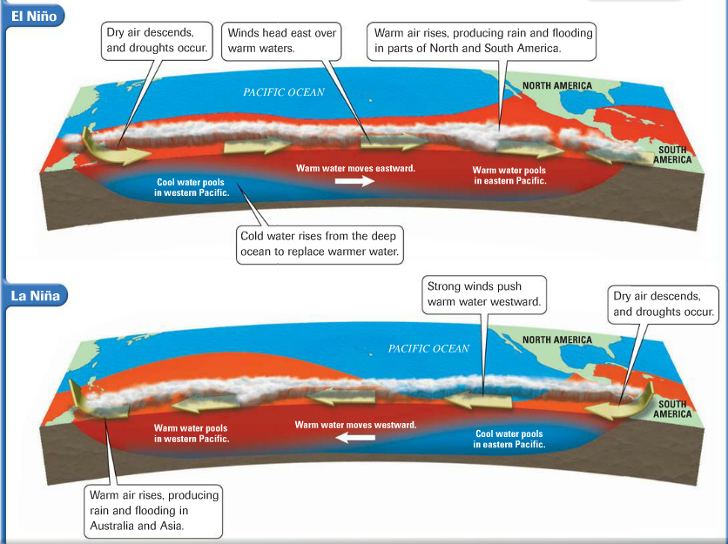
Changes in Climate
El Niño
• El Niño—winds push warm Pacific Ocean waters toward the Americas
• La Nina—winds push warm waters toward Australia and Asia
• Both cause natural, worldwide changes in climate

Slide 17
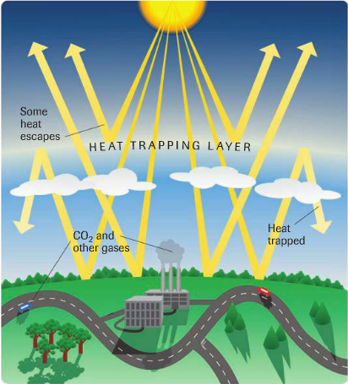
Changes in Climate
Global Warming
• Gradual warming of the earth’s atmosphere
• Greenhouse effect—the earth warms due to trapped solar energy

Slide 18
Section 3: World Climate Regions
Temperature and precipitation define climate regions.
• Broad climate definitions help to identify variations in weather at a location over the course of a year.

Slide 19
Defining a Climate Region
Typical Weather
• Temperature and precipitation define climate
• Location, topography, elevation may impact climate
• Five general climate regions:
- tropical (low-latitude)
- dry
- mid-latitude
high latitude
highland

Slide 20
Types of Climates
Tropical Wet
• Always hot; daily rainfall adds up to more than 80” annually
Tropical Wet and Dry
• Warm, wet summer season; cooler, dry winter season
Semiarid
• Hot summers; mild to cold winters; little precipitation
Desert
• Two kinds of desert—hot, cool/cold; less than 10” rain per year

Slide 21
Types of Climates
Mediterranean
• Summers dry and hot; winters cool and rainy
Marine West Coast
• Moderate temperatures; frequently cloudy, foggy, damp
Humid Subtropical
• Long periods of summer heat and humidity; winters mild to cool
Humid Continental
• Great variety of temperature, precipitation; four distinct seasons

Slide 22
Types of Climates
Subarctic
• Summers are short and cool; winters are long and very cold
Tundra
• Tundra—flat, treeless ring of lands around the Arctic Ocean
• Very little precipitation; summer temperatures around 40˚ F.
• Permafrost is the constantly frozen subsoil found in this region
Ice Cap
• Snow, ice, permanently freezing temperatures

Slide 23
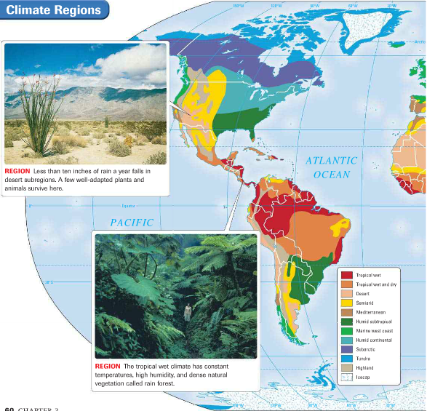
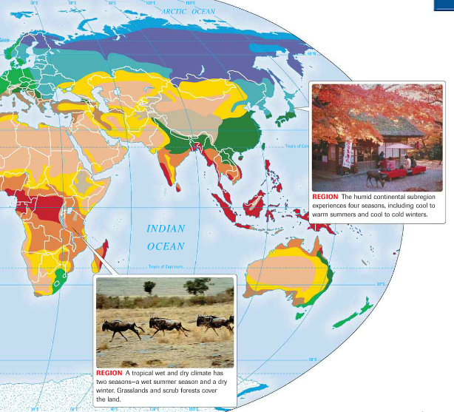
Types of Climates

Slide 24
Highlands
Climate varies with latitude, elevation, topography, location

Slide 25
Section 4: Soils and Vegetation
Soil and climate help to determine the vegetation of a region.
Human land use alters the vegetation in both positive and negative ways.

Slide 26
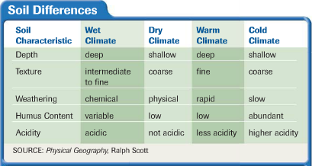
Soil Regions
Shaping Human Existence
• Soil is a thin layer of weathered rock, humus, air, water
• Topsoil refers to the top 6” of soil
• Soil characteristics vary with climate
• Type of soil determines type of vegetation that can be supported
• Type of vegetation determines type of possible human activity

Slide 27
Vegetation Regions
Natural Environments
• Ecosystem—interdependent community of plants and animals
• Biome—the ecosystem of a region
• Biomes are further divided into:
- forest
- grassland
- desert
- tundra

Slide 28
Vegetation Regions
Forestlands
• Forest regions categorized by trees they support—broadleaf or needle
• Deciduous—broadleaf trees: maple, oak, birch, cottonwood
- mostly in Northern Hemisphere
• Rain forest—tropical forest covered with broadleaf trees
• Coniferous—needle leaf trees; cone bearing: pine, fir, cedar
- mostly in Northern Hemisphere
• Deciduous and coniferous trees together form mixed forest

Slide 29
Vegetation Regions
Grasslands
• Flat regions with few trees
• A savanna is a tropical grassland
• Steppe, or prairie, are temperate grasslands of Northern Hemisphere
Desert and Tundra
• Plants in these regions have adapted to climate extremes:
- tundra plants (mosses, lichen) hug the ground
- desert plants (cacti, sagebrush) conserve water, withstand heat

Slide 30
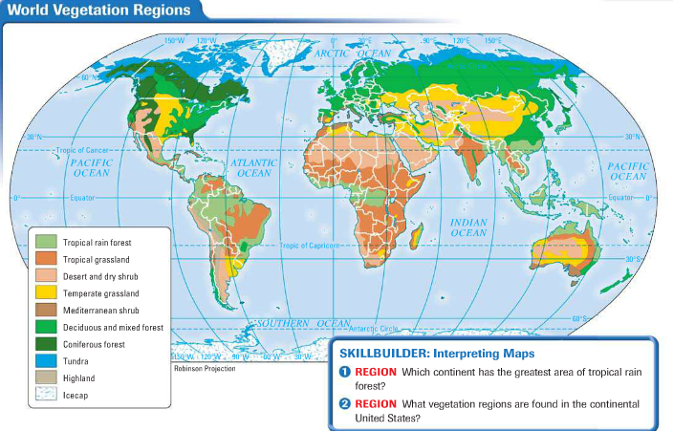
Vegetation Regions

Slide 31
Human Impact on the Environment
Altering the Landscape
• Humans either adapt to land, or alter it to meet their needs
• Some human activities that affect the environment:
- building dams
- installing irrigation systems
- planting crops
- slashing and burning vegetation

